Slide 1
Predict if a Individual is Professional Developer

Slide 2
Problem Identification

Slide 3
Our Problem and Solution
Problem - Increase the effectiveness and efficiency of Stackoverflow community by enabling it to easily identify Professional Developers so that enabling them to focus on improving the community more
Solution - Craft a Machine Learning Model to classify individuals into two categories that identifies them as Developer by Profession or not

Slide 4
Data Available
Format - Single CSV file
Type - Detailed Survey data conducted within Stackoverflow Communtiy for the year 2020
Contains
Development Type, Employment Type, Job Satisfaction Level
Age, Educational Qualification, etc.

Slide 5
Modeling Analysis

Slide 6
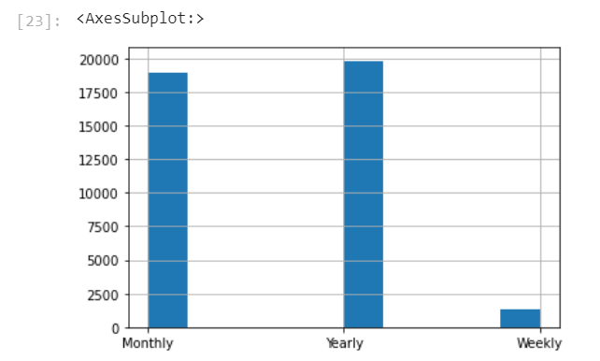
Compensation received by Individuals
We can observe the following relations
Most of the Individuals Compensation in either Monthly or Yearly Format

Slide 7
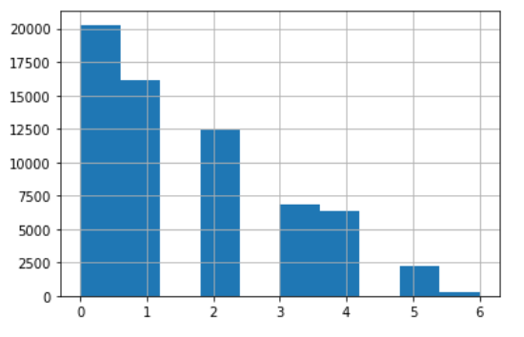
Analysis of years of coding data
We can observe the following relations
As the years of experience increases the individuals give less time in the stack overflow community

Slide 8
Summary
We have successfully classified individuals into two classes to indicate if they are either developer by profession or not
We can now use this classification to identify professional individuals and there by enabling them to contribute more to our Stack Overflow Community

Slide 9
This model helps us to correctly classify Professional Individuals from non professional ones

Slide 10
Thanks everyone, I am happy that you all had a pleasant experience and is more clear regarding approach after this presentations

